Slide 1

Supine - team presentation
Zack Hawkins
Josie Wood
Alexander Pritchard
Solomon Cammack

Slide 2

TEAM ROLE INTRODUCTIONS

Slide 3
Zack
Primary Role:
Product Owner
Secondary Role(s):
Secondary Designer
Client Liason

Slide 4
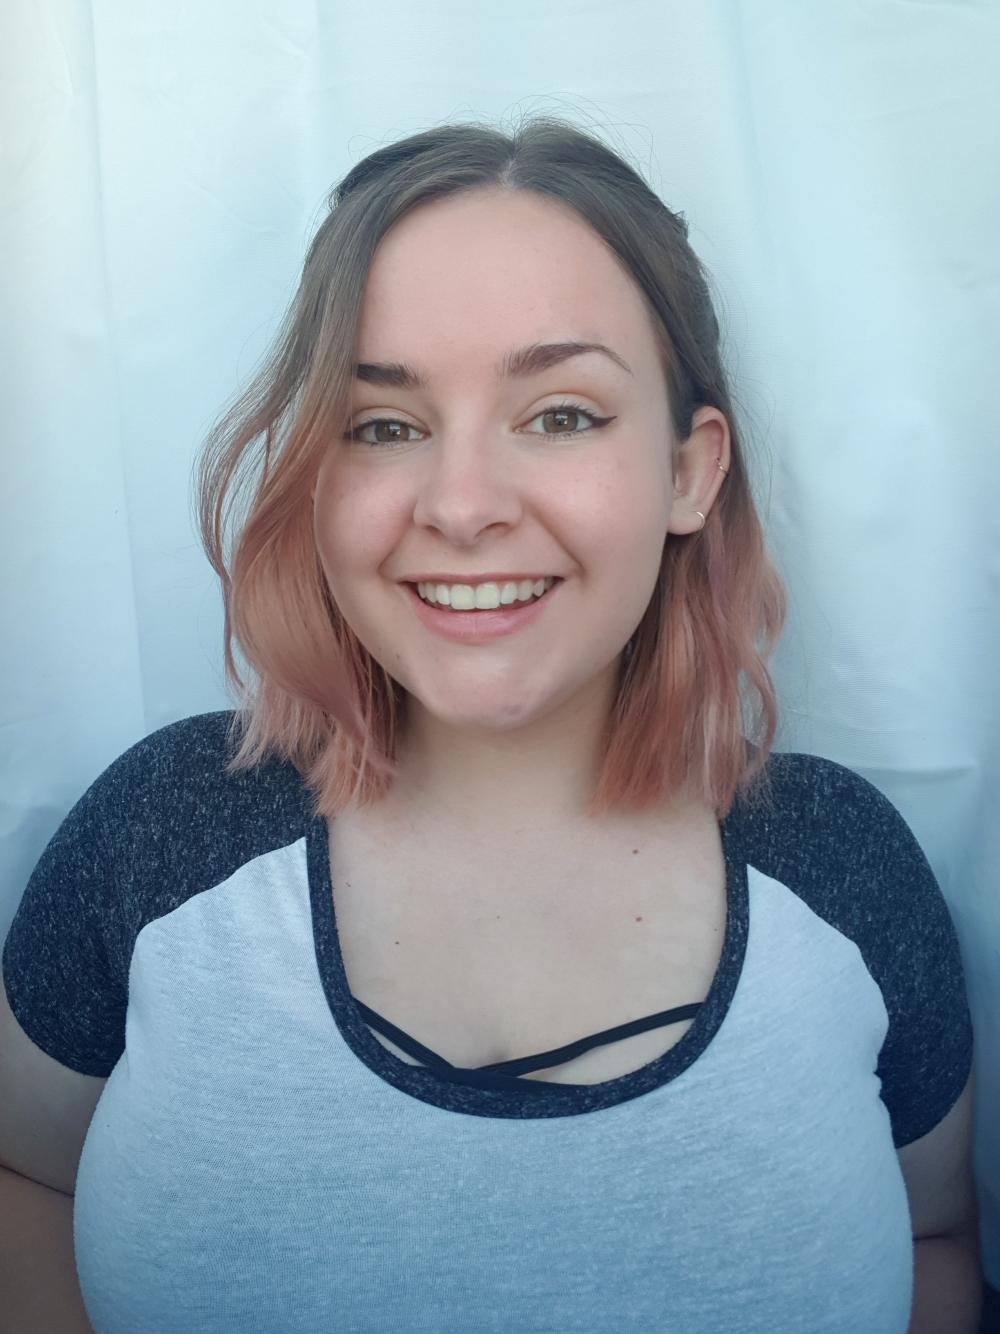
Josie
Primary Role:
Scrum Master
Secondary Role(s):
Lead Designer
QA Tester

Slide 5
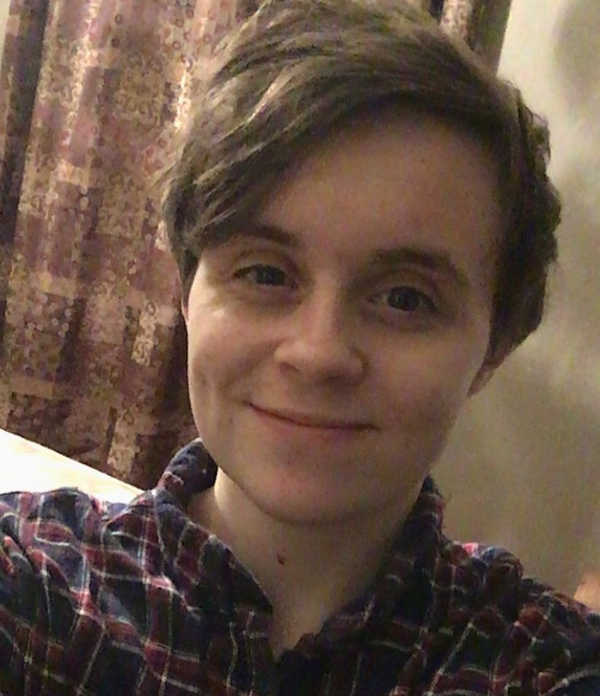
ALEXANDER
Primary Role:
Technical Lead
Secondary Role(s):
Codebase Manager
QA Tester

Slide 6
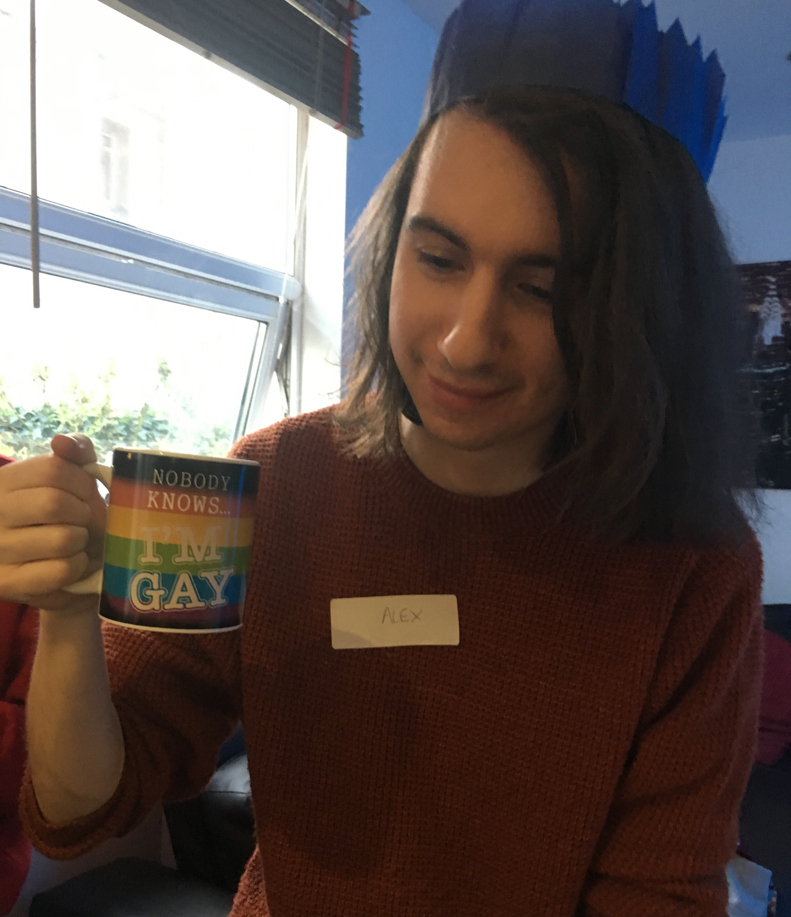
SOLOMON
Primary Role:
Technical Lead
Secondary Role(s):
Repo Manager
Technical Relations Manager

Slide 7
Our client

Slide 8
Communication – with the client

Slide 9
Agreed objectives
Dungeon Crawler game which works as a single player game (game loop isn’t dependant on player 2, can still win or lose without them)
Child can connect to game using a webapp on a tablet with a unique code, like Jackbox games
At least 3 levels of varying difficulty to keep gameplay interesting
Random generation of rooms to vary gameplay
At least 2 variants of enemies, with animations
Webapp has limited text and basic controls so it’s easy for young children to understand
Child-friendly gameplay – no graphic violence

Slide 10
Processes used

Slide 11
The final product

Slide 12
implementation

Slide 13
implementation [ALEX AND SOLOMON]

Slide 14
testing

Slide 15
Code standards

Slide 16
version control

Slide 17
reflection

Slide 18
links

